Slide 1
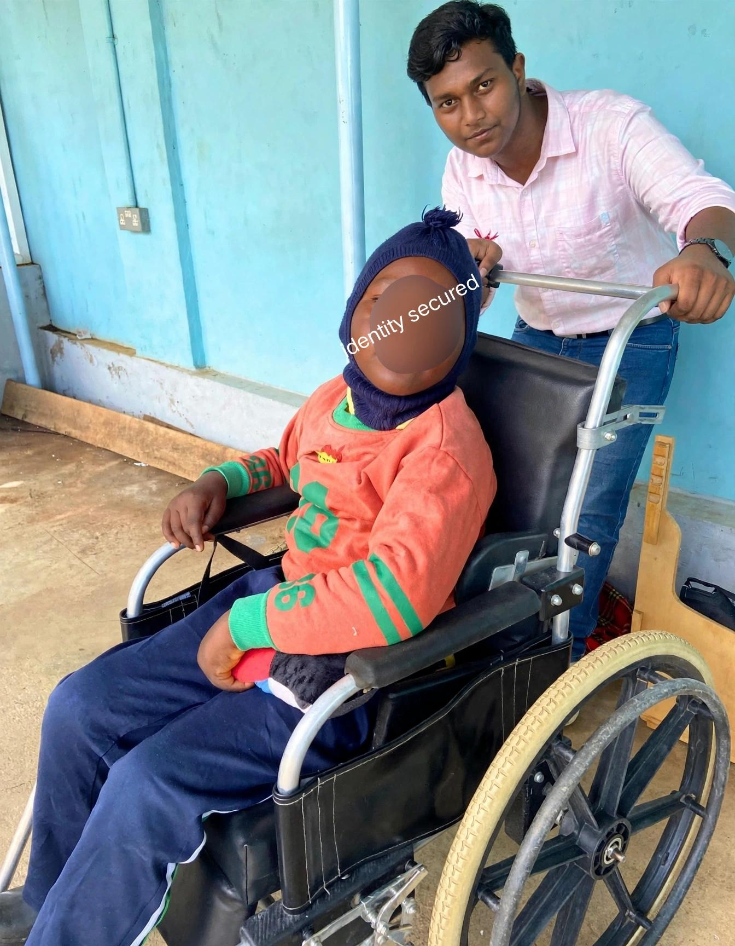
VIVO IGNITE NATIONAL FINALE · BHARAT MANDAPAM, NEW DELHI
PROJECT IRIS · v2.0
A Blink Becomes a Click. A Tilt Becomes a Cursor.
An ₹800 open-source assistive wearable restoring full digital agency and voice communication to patients with Locked-In Syndrome, ALS & severe paralysis.
950nm Optical Reflectance
Digital eye open/close
6-DOF Inertial Steering
Smooth MPU6050 head tilt
BLE 5.0 + Wi-Fi Telemetry
Thumb-sized ESP32-C3
₹800 vs ₹25,00,000
99.96% price disruption
Ayushman Choudhary · Class 10th
Bhavan’s B.P. Vidya Mandir Ashti, Nagpur, Maharashtra
● LIVE HARDWARE PROTOTYPE · READY FOR DEMO

Slide 2
PROJECT IRIS V2.0 · KIOSK DISPLAY
VIVO IGNITE NATIONAL FINALE · BHARAT MANDAPAM
THE CRISIS · LOCKED-IN SYNDROME & ALS
Trapped Inside a Conscious Mind.
240K+
PARALYZED INDIANS
Living with locked-in syndrome, ALS, stroke & severe spinal injuries with fully intact cognitive minds.
₹25L+
COMMERCIAL MONOPOLY
Imported optical eye-trackers (Tobii Dynavox) cost as much as a luxury car—financially impossible for Indian families.
0
AFFORDABLE OPTIONS
Zero reliable, high-accuracy sub-₹2,000 assistive cursor devices exist in the healthcare market today.
THE CLINICAL REALITY:
Paralyzed individuals lose peripheral limb movement, but in over 95% of cases, two voluntary motor signals remain intact: micro head rotation and deliberate eye blinks. IRIS bridges these exact two biological channels into a high-precision computer mouse for ₹800.

Slide 3
PROJECT IRIS V2.0 · KIOSK DISPLAY
VIVO IGNITE NATIONAL FINALE · BHARAT MANDAPAM
DISRUPTIVE INNOVATION
The ₹800 Breakthrough: 99.96% Cheaper.
COMMERCIAL STATUS QUO
Tobii Dynavox I-Series: ₹25,00,000+
• High-speed binocular cameras that fail under sunlight or lens glare
• Forces purchase of proprietary locked 4kg tablets
• Requires 30+ minutes tedious calibration by clinical specialists
• Closed patent monopoly with 40-60% Indian import customs duty
• Result: Completely inaccessible to 99.9% of Indian patients
PROJECT IRIS DISRUPTION
Total Prototype BOM: ₹800
✔ 950nm Optical Reflectance: Works in total darkness or direct sunlight
✔ Works on any existing family laptop, PC, Android, or tablet
✔ Self-calibrating in 2–3 seconds with saved returning user profiles
✔ Built using locally available off-the-shelf micro-electronics
✔ 100% Free & Open-Source (CERN-OHL & GPL): Reproducible anywhere
PRICE DISRUPTION: 99.96% CHEAPER | CALIBRATION: 2–3 SECONDS | BATTERY RUNTIME: 12+ HOURS

Slide 4
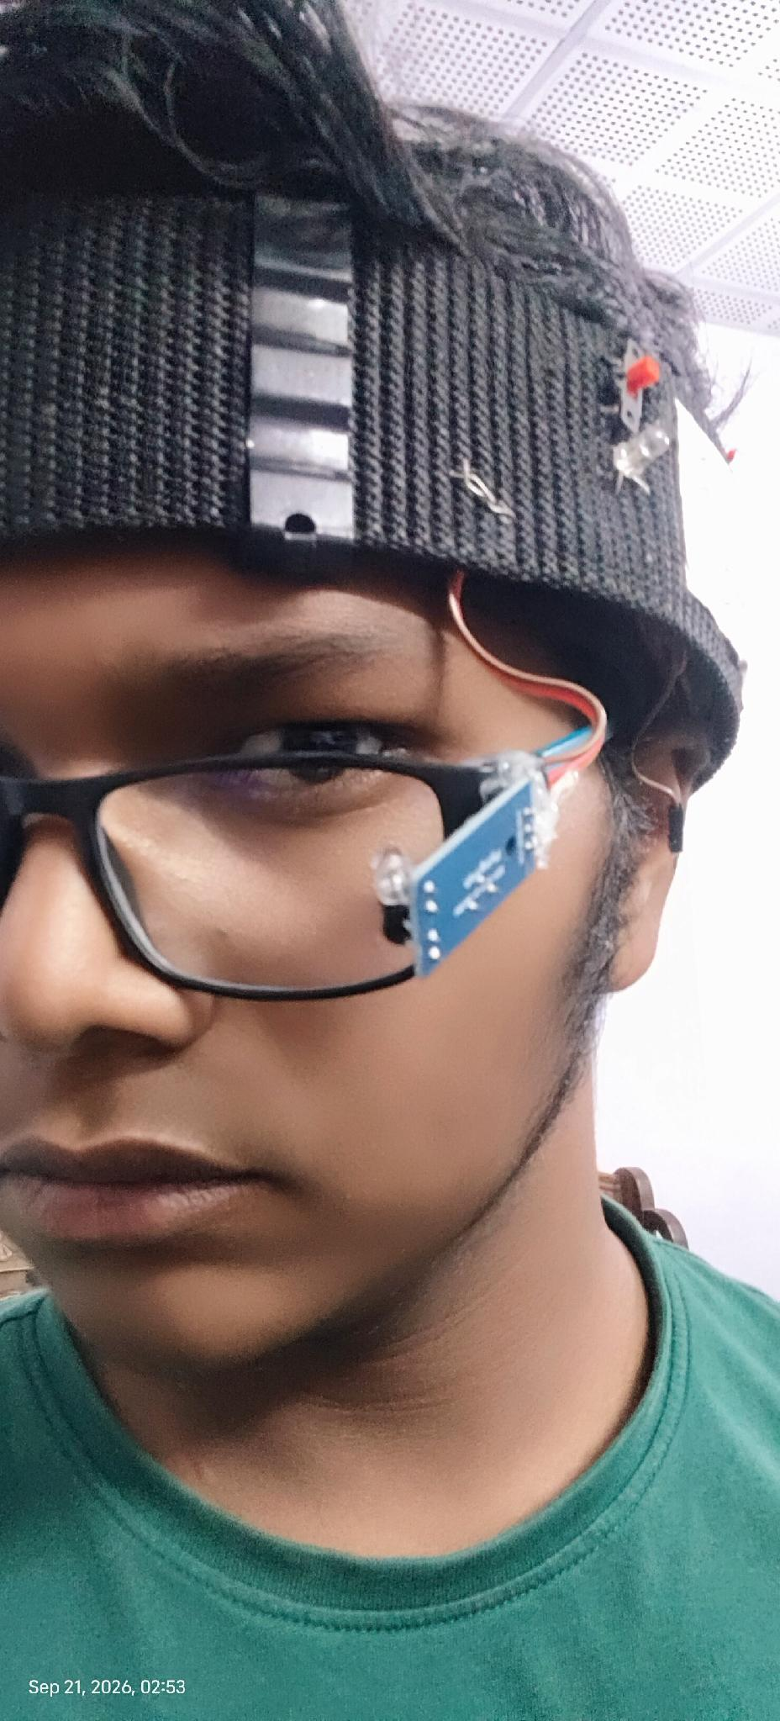
PROJECT IRIS V2.0 · KIOSK DISPLAY
VIVO IGNITE NATIONAL FINALE · BHARAT MANDAPAM
HARDWARE ERGONOMICS & THERMAL DESIGN
Two Detached Systems. Zero Scalp Heating.
RIG 1: AIRFLOW HEADBAND
Perforated Mesh Belt
• Houses Seeed XIAO ESP32-C3, MPU6050 IMU, Li-Po & safety fuses
• Continuous Scalp Airflow: Breathable anti-sweat mesh prevents heating
• Zero Rigid Plastics: Eliminates pressure ulcers on bedridden patients
• Featherweight: Entire headband rig weighs less than 58 grams
• Soft Velcro cinch adjusts to any adult or pediatric head circumference
RIG 2: MAGNETIC EYEWEAR
N52 Quick-Snap Pivot
• Glasses carry ONLY the ultra-light 950nm IR sensor (zero electronics)
• N52 Neodymium Snap: Put glasses on first, snap sensor on in 1 second
• Universal Rx Support: Fits any frame and up to ±7.0D prescription lenses
• Friction Nut-Bolt Pivot: Easy angle adjustment without bending wires
• Overcomes Camera Glare: Positions optical beam below lens reflection lines

Slide 5
PROJECT IRIS V2.0 · KIOSK DISPLAY
VIVO IGNITE NATIONAL FINALE · BHARAT MANDAPAM
TRANSPARENT ENGINEERING
Every Rupee Engineered for Maximum Accessibility.
SEEED STUDIO XIAO ESP32-C3
BOM COST: ₹250
RISC-V 32-bit @ 160MHz, BLE 5.0 + Wi-Fi, integrated Li-Po charge circuit eliminates bulky external power shields.
MPU6050 6-DOF IMU SENSOR
BOM COST: ₹120
Fast I2C @ 400kHz, 3-axis gyro + accel, streams 50Hz continuous pitch/roll for smooth cursor steering.
950NM MULTI-BEAM IR MODULE
BOM COST: ₹100
Safe diffused infrared (<0.5 mW/cm²), onboard LM393 analog comparator gives instantaneous hardware digitalRead.
3.7V 1000MAH LI-PO BATTERY
BOM COST: ₹125
Direct charging via XIAO pads, 12+ hours continuous runtime with Deep Sleep firmware and 2A safety fuse protection.
N52 MAGNETIC PIVOT MOUNT
BOM COST: ₹75
Quick-release neodymium magnetic mount + friction pivot; zero lens scratching; fits custom prescription frames.
MEDICAL VENTILATED HEADBAND
BOM COST: ₹130
Perforated airflow fabric, soft Velcro closure, zero pressure points, total rig weight under 58 grams.
TOTAL SYSTEM BUILD COST: ₹800 | COMMERCIAL TOBII: ₹25,00,000+ | SAVINGS: 99.96%

Slide 6
PROJECT IRIS V2.0 · KIOSK DISPLAY
VIVO IGNITE NATIONAL FINALE · BHARAT MANDAPAM
PHYSICAL SENSING ENGINE
How Light Reads the Eye in Darkness & Sunlight.
OPEN EYE · CURSOR ACTIVE
High Reflectance (94%)
• 950nm diffused infrared beam directed at outer canthus of the eye
• White sclera tissue reflects optical energy strongly back to phototransistor
• Sensor outputs steady HIGH voltage state (~94% reflectance)
• Microcontroller interprets state as ACTIVE EYE: cursor steers smoothly
CLOSED EYE · CLICK TRIGGER
Low Reflectance (<20%)
• When patient closes eyelid, skin absorbs and deflects the 950nm beam
• Immediate sharp drop in optical energy reaching phototransistor
• Sensor outputs LOW voltage state (<20% reflectance)
• Firmware timer initiates blink duration measurement for click classification
LM393 HARDWARE COMPARATOR
Zero MCU Lag / Analog Silicon
• Onboard LM393 comparator compares reflectance against calibrated threshold
• Decides open vs. closed in pure analog silicon in less than 1 microsecond
• Firmware uses digitalRead() instead of analogRead()—zero ADC compute waste
• Immune to ambient light: works identically in pitch darkness or direct sunlight

Slide 7
PROJECT IRIS V2.0 · KIOSK DISPLAY
VIVO IGNITE NATIONAL FINALE · BHARAT MANDAPAM
GESTURE & TIMING LOGIC
Separating Conscious Intent from Involuntary Reflex.
NATURAL REFLEX BLINK
< 200 ms
ACTION: Completely Ignored
Fast involuntary corneal hydration blink. Filtered out before any click event is generated. Cursor never twitches or misfires.
SINGLE DELIBERATE BLINK
200 – 500 ms
ACTION: Left Click (LC)
Deliberately held blink beyond reflex threshold. Emits a clean Left Click to select menu tiles, emergency alarms, or trigger speech.
DOUBLE DELIBERATE BLINK
2x < 600 ms
ACTION: Right Click (RC)
Two held blinks in quick succession within a 600ms timing window. Emits an instant Right Click for secondary context options.
ERGONOMIC CLUTCH
> 1000 ms
ACTION: Re-Zero Horizon
Holding eye closed for over 1 second acts as a digital clutch, instantly resetting cursor center point to eliminate patient neck fatigue.
TENSORFLOW EMBEDDED NOISE FILTER & TREMOR SUPPRESSION
Patients with ALS and severe motor disorders suffer from involuntary neck spasms and micro-tremors. The IRIS Python pipeline applies an adaptive moving-average Kalman filter and lightweight TensorFlow neural model to suppress physiological noise, delivering rock-steady cursor telemetry.

Slide 8
PROJECT IRIS V2.0 · KIOSK DISPLAY
VIVO IGNITE NATIONAL FINALE · BHARAT MANDAPAM
CLINICAL SIMPLICITY
Calibrates in 2–3 Seconds. Zero Specialists Needed.
STEP 1
CONNECT
Launch Python app. Advertises BLE 5.0 at 2Hz. Instant wireless handshake with PC or phone.
STEP 2
USER CHECK
Detects new vs. returning patient. Returning users load profile in <1s, skipping calibration.
STEP 3
GESTURE LOCK
Gentle nod up/down & tilt left/right. Learns patient's comfortable neck range & sets dead-zones.
STEP 4
BLINK LOCK
2 deliberate blinks (takes 2–3 seconds). Locks optical reflectance threshold & syncs eye twin.
STEP 5
CURSOR READY
Cursor goes live immediately. Fully drives OS, universal assistive apps, or games.
THE CALIBRATION DISRUPTION:
Commercial eye trackers demand 30–45 minutes of painful 9-point screen staring with a trained clinical technician present. If the patient shifts slightly in bed, tracking is lost and the 30-minute test must restart. IRIS auto-calibrates in 2–3 seconds and stores personalized profiles permanently.

Slide 9
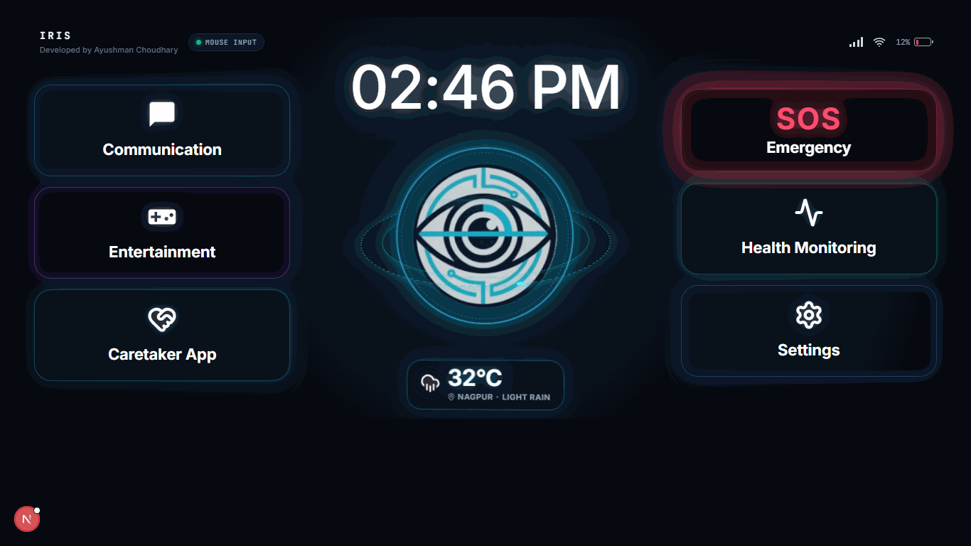
PROJECT IRIS V2.0 · KIOSK DISPLAY
VIVO IGNITE NATIONAL FINALE · BHARAT MANDAPAM
PATIENT SOFTWARE ECOSYSTEM
One Streamlined Screen. Everything They Need.
4 CORE ACCESSIBLE TILES
Engineered for Bedridden Independence
● COMMUNICATION HUB
High-contrast tiles for Water, Rest, Call & AI Speech. Patients express essential daily needs in a single deliberate blink.
● EMERGENCY SOS SIREN
Instant one-blink caregiver alarm. Dispatches push notifications via ntfy.sh and sounds an acoustic alarm in under 145ms.
● HEALTH & VITALS TRACKER
Daily pain rating scale, posture comfort log, and medication reminders accessible to caregivers and visiting nurses.
● SMART ROOM IoT RELAY
Direct local Wi-Fi control: toggle room lights, ceiling fans, and adjust motorized bed tilt without speaking a word.

Slide 10
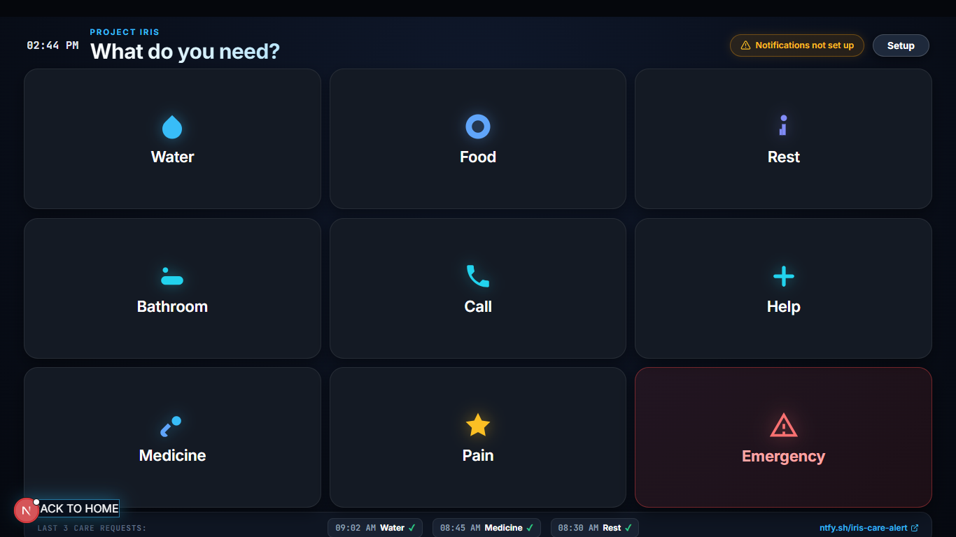
PROJECT IRIS V2.0 · KIOSK DISPLAY
VIVO IGNITE NATIONAL FINALE · BHARAT MANDAPAM
ARTIFICIAL INTELLIGENCE
Telegraphic Words In. Articulate Speech Out.
THE FATIGUE PROBLEM
Motor Fatigue Halts Typing
Typing a 15-word sentence with an eye cursor requires over 60 deliberate saccades and blinks. Paralyzed patients exhaust their energy within minutes.
THE GEMINI AI EXPANSION ENGINE:
1. Patient Selects 3 Words: [ Pain ] [ Left Shoulder ] [ Sharp ]
2. Gemini Multimodal Context Model Ingests: Time of day, posture logs, clinical history.
3. Expanded Output: 'I am experiencing a sharp pain in my left shoulder; could you please help me readjust my pillows?'
4. Patient Agency Safeguard: Patient confirms preview before Web Speech speaks aloud!

Slide 11
PROJECT IRIS V2.0 · KIOSK DISPLAY
VIVO IGNITE NATIONAL FINALE · BHARAT MANDAPAM
MARKET BENCHMARK
Commercial Monopoly vs. Open-Source Breakthrough.
FEATURE / METRIC | COMMERCIAL TOBII DYNAVOX | PROJECT IRIS (v2.0)
Retail Price in India | ₹25,00,000+ (Extreme cost barrier) | ₹800 (99.96% Cheaper!)
Sensing Technology | Binocular high-speed optical cameras | 950nm Reflectance + 6-DOF IMU
Ambient Light Immunity | Fails in direct sun or dark rooms | Works in pitch black darkness or daylight
Calibration Time | 30–45 mins (Trained clinical specialist) | 2–3 seconds (Fully self-calibrating)
Prescription Eyewear | Lens reflections cause severe tracking loss | Fits any frame & up to ±7.0D lenses
Hardware Portability | Forced proprietary locked 4kg tablet | Runs on family's existing PC/laptop/phone
Open Source / Replicable | Closed commercial patent monopoly | 100% Free & Open-Source (CERN-OHL)

Slide 12
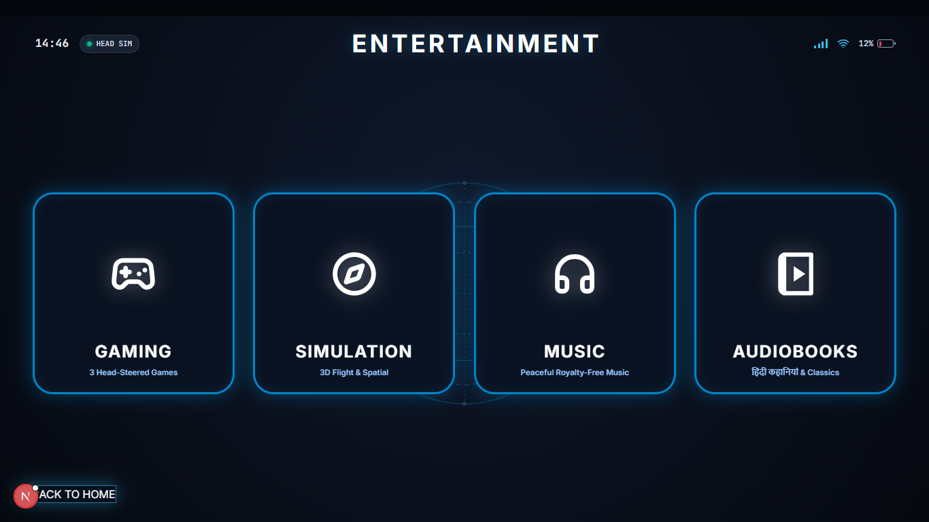
PROJECT IRIS V2.0 · KIOSK DISPLAY
VIVO IGNITE NATIONAL FINALE · BHARAT MANDAPAM
REHABILITATION & GAMING DIVERSIFICATION
Restoring Joy, Play, and Future Market Scale.
PILLAR 1: DIGITAL THERAPEUTICS & REHAB
Combatting Sensory Deprivation in ALS
• Bedridden isolation causes cognitive decline and severe clinical depression
• Gaze Dino Runner: Playable browser game rehabilitates ocular motor control
• 360° Cockpit Flight Simulator: Paralyzed patients explore skies via head motion
PILLAR 2: HANDS-FREE CONSUMER GAMING
Cross-Subsidizing Free Medical Units
✔ Enables amputees, injured soldiers, and mobility-impaired players to game
✔ MPU6050 head tilt maps to 360° crosshair aiming; blinks act as fire triggers
✔ Mass-Market Scale: High-volume consumer gaming adoption subsidizes free medical units
INNOVATION MODEL: Accessible consumer gaming profits fund free medical distribution to rural hospitals across India.

Slide 13




PROJECT IRIS V2.0 · KIOSK DISPLAY
VIVO IGNITE NATIONAL FINALE · BHARAT MANDAPAM
ETHICAL RESPONSIBILITY & SCALING
Engineered for the United Nations Global Goals.
SDG 3
GOOD HEALTH & WELL-BEING
Restoring voice, communication, and emotional agency to paralyzed and locked-in individuals.
SDG 9
INDUSTRY, INNOVATION & INFRASTRUCTURE
Frugal, open-source hardware engineering replacing costly multi-lakh monopolies.
SDG 10
REDUCED INEQUALITIES
Demolishing financial walls so rural and lower-income families receive equal healthcare access.
SDG 17
PARTNERSHIPS FOR THE GOALS
Open-source schematics and firmware empowering NGOs, neurology wards, and makers worldwide.

Slide 14
PROJECT IRIS V2.0 · KIOSK DISPLAY
VIVO IGNITE NATIONAL FINALE · BHARAT MANDAPAM
VIVO IGNITE NATIONAL FINALE · BHARAT MANDAPAM
Technology Should Be a Bridge, Not a Wall.
“For a paralyzed human trapped inside their own mind, technology should be an immediate bridge of communication — never an unreachable multi-lakh financial wall.”
— Ayushman Choudhary, Creator of Project IRIS
MAKE IN INDIA
100% locally sourceable components, zero imported monopolies, manufactured for ₹800.
HOSPITAL & HOME READY
Plug-and-play wireless telemetry ready for neurology ICUs, rural clinics, and home care.
OPEN HARDWARE MOVEMENT
Full circuit schematics, firmware code, and AI models freely published to empower global makers.
Ayushman Choudhary · Class 10th · Bhavan's B.P. Vidya Mandir Ashti, Nagpur, Maharashtra
PROJECT IRIS | INFRARED REFLECTIVE INTERFACE SYSTEM | VIVO IGNITE NATIONAL FINALE

